Slide 1
Wave Particle Duality

Slide 2
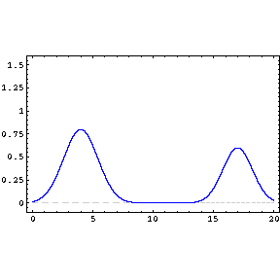
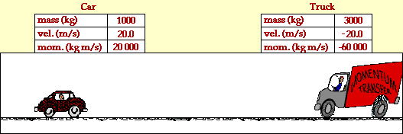
Wave and Particle: Properties
Wave
Particle
Spread in space (wavelength) and time (frequency)
Can be superimposed (pass through) on each other
Identified by:
Wavelength,
Frequency
Amplitude
Intensity
Energy
Localized in space and time
Cannot pass through each other
Identified by:
Mass
Momentum
Kinetic energy
Spin
Electric charge

Slide 3
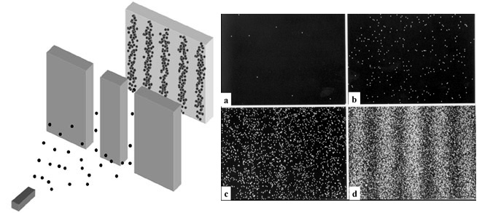
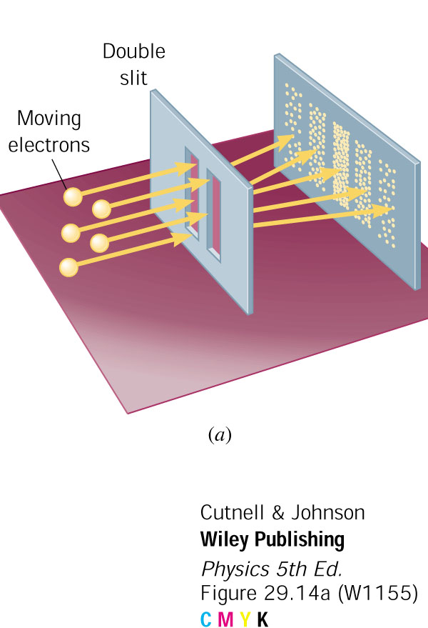
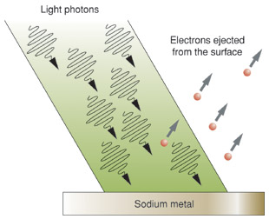
Wave Particle Duality
Particle Nature of Light
Photoelectric effect
Compton effect
Wave Nature of Particle
Electron diffraction
When electrons fired toward a slit for which d < l, a diffraction pattern is seen

Slide 4
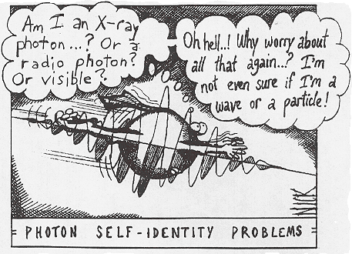
Wave Particle Duality

Slide 5

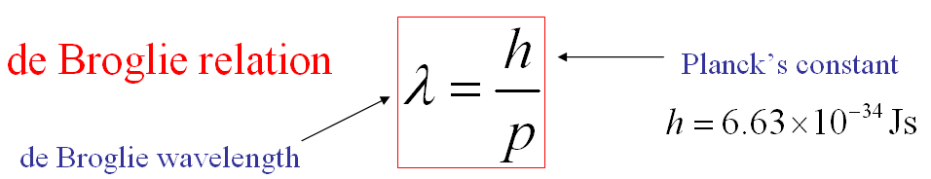
de Broglie hypothesis
A moving particle in quantum theory
A moving particle always has a wave associated with it and the motion of the particle is guided by that wave.
The electrons, protons, atoms and molecules, when in motion, have some type of wave motion associated with them (matter waves)
Matter waves can propagate in vacuum → not mechanical waves
Matter waves are associated with motion of neutral bodies → not electromagnetic waves.

Slide 6
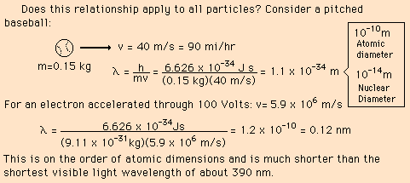

Slide 7
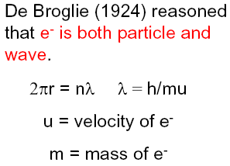
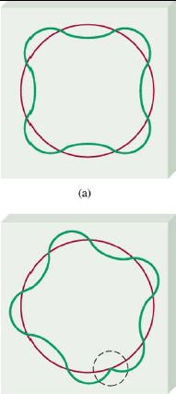
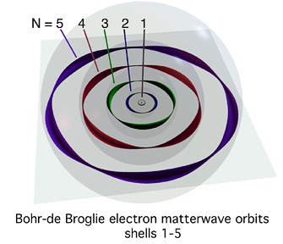
Bohr orbit and de Broglie wave

Slide 8
De Broglie wavelength in terms of KE

Slide 9

Phase velocity (wave velocity)
De Broglie wave is associated with every material particle
As particle moves, wave also moves
Phase Velocity → the speed with which De Broglie wave travels
Consider particle velocity = v
phase velocity for that particle = u = c²/v
for a material particle, v << c
phase velocity (u) > particle velocity (v)
unexpected: as u should be equal to c

Slide 10
Group velocity (particle velocity)
A wave packet (group of waves) is associated with a material particle
Individual waves travel inside the group with their phase velocities
A group of waves travel with velocity known as group velocity
A wave packet can be obtained by interference of many waves of different frequencies and amplitude
Near the vicinity of the particle → high amplitude
Amplitude is attenuated away from particle
It can be shown that: group velocity = particle velocity

Slide 11
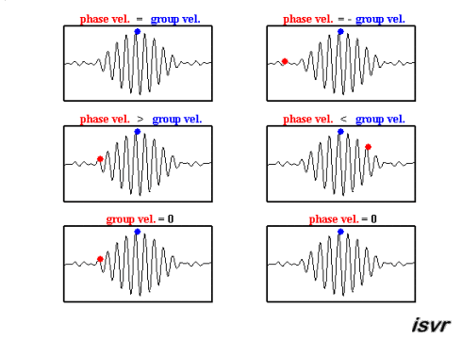
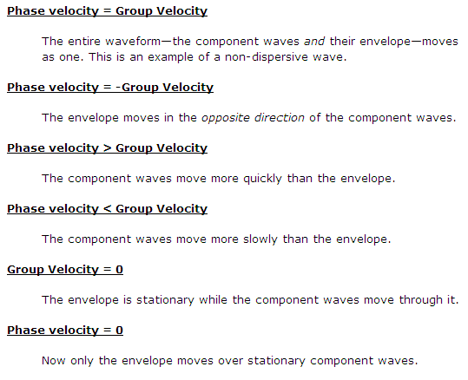
Group velocity and phase velocity

Slide 12
Properties of matter waves
Wavelength of matter wave = λ = h/mv
λ ∝ 1/m ➔ As m↓ (lighter particle) → λ↑
λ ∝ 1/v → As v↓ (particle velocity) → λ↑
If v=∞ → λ=0 ➔ finite velocity for matter waves
If v=0 → λ= ∞ ➔ finite velocity for matter waves
Matter waves are different than em waves associated with particle
λ is independent of charge of particle
Velocity of matter waves depends on velocity of particle generating it
Matter wave spread out in space and not localized at a point → introduces uncertainty in the position of the particle

Slide 13
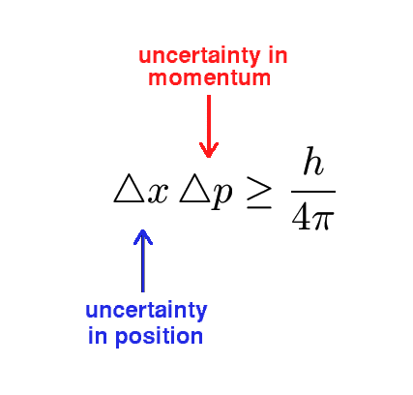
Heisenberg’s Uncertainty Principle
The position and momentum of a particle cannot be simultaneously measured with arbitrarily high precision
Even with perfect instruments and technique, the uncertainty is inherent in the nature of things
At the size of atomic dimensions
particle isn’t like a hard sphere
smaller the dimension, the more wave-like nature

Slide 14
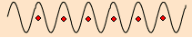
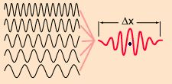
Heisenberg’s Uncertainty Principle
λ is precisely known
- p= h/λ is precisely known
- x is unknown
- Uncertainty in position of particle
Probable positions of the particle
Position is precise
- x is precise
- But, as resultant wave is
superposition of many
waves, uncertainty in
wavelength
- Introduces uncertainty in momentum
Most probable position of the particle

Slide 15
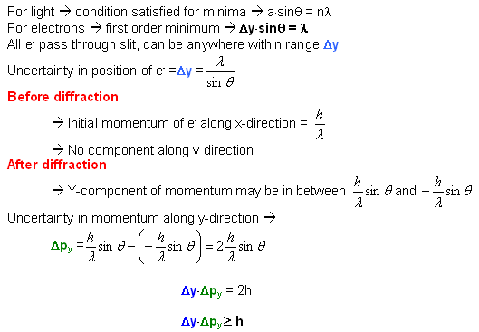
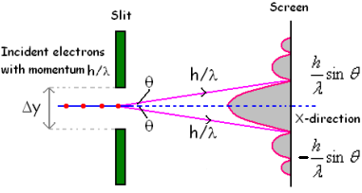
HUP: Illustration by diffraction at single slit

Slide 16
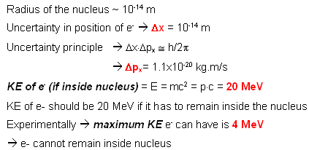
HUP: An e⁻ cannot sustain inside nucleus

Slide 17
Wave Equations
An introduction to
Quantum Mechanics

Slide 18
Classical Mechanics
What is classical mechanics?
Formulated to explain the behavior of macroscopic objects
Motion of macroscopic particles obeys Newton’s laws of motion
State of a particle is defined by: Knowledge of the INITIAL STATE
Requires knowledge of – forces, position and velocity
Prediction of FUTURE states is possible
Limitations of Classical Mechanics
Theories could not explain black body radiations
Could not explain photoelectric effect
Could not explain diffraction patterns of particle beam

Slide 19
Quantum Mechanics
Quantum mechanics (QM)
Examples of microscopic systems: electrons, protons, nuclie, etc
Microscopic system shows wave-particle duality
QM is Mathematical framework for microscopic systems
Werner Heisenberg, Max Born and Pascual Jordon (1925)
First mathematical formulation explaining discrete nature of light and matter
Able to describe the behavior of microscopic particles
Erwin Schrödinger (1926)
A new mathematical formulation of QM (~ to Newton’s 2nd law )
Proposed a differential equation and its solution
Able to predict behavior of microscopic particles

Slide 20
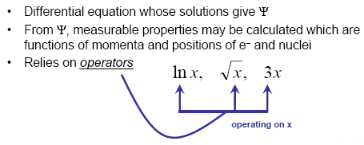
Schrödinger’s equation
Schrödinger equation in QM ≡ Newton’s laws in CM
It predicts the future behavior of a dynamic system
It is a wave equation predicts the probability of events or outcome.
An operator acts upon the wavefunction to generate the evolution of the wavefunction in time and space
Schrödinger equation predicts – atomic spectrum of hydrogen, energy levels of Plank’s oscillator, non-radiation of electrons in atom, shift in energy levels in a strong electric field, etc.

Slide 21
Schrödinger's Equations
Time Independent Form
Time Dependent Form

Slide 22
Physical Interpretation of Ψ and |Ψ|²
A wave is produced only when something oscillates
For light, something ≡ em field, sound ≡ pressure
What oscillates to produce matter waves?
Represent that quantity by a wave function Ψ (analogous to y in displacement in string)
Ψ ≡ amplitude of matter wave
A periodic change in Ψ produces matter waves
Ψ is function of position and time
Ψ(x,y,z,t) = Ψ(q,t)
For many particles, Ψ(q₁,q₂,…,t)
Ψ → related with probability of finding a particle at that space & time
Greater the amplitude of matter wave greater is value of Ψ
Amplitude can be positive or negative
Negative amplitude → negative probability →meaningless
Ψ is complex but |Ψ|² = Ψ Ψ* is always real and positive
|Ψ|² can have any value between 0 and 1
|Ψ|² = 0 →particle is absent, |Ψ|² =1 → particle is present
|Ψ|² = 0.2 → 20% probability that particle is present
|Ψ|² represent probability density

Slide 23
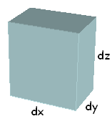
What is Ψ²?
For a single particle
at time t, the wave function is Ψ(x,y,z,t)
probability that at time t, the particle is in a given volume of space (dx·dy·dz) is given by
|Ψ(x,y,z,t)|² dx·dy·dz
Particle can be found somewhere in space

Slide 24
Conditions to be obeyed by Ψ
Normalizable function
Probability of finding particle somewhere is 100%
Single value function
Ψ ≡ probability → can have only one value
Finite function
Particle exists somewhere in space → integration over all space must be finite
Continuous function
Ψ and its first order derivatives must be continuous

Slide 25
Schrodinger’s equation
His great discovery, Schrödinger's wave equation, is below. H-bar is Planck’s constant, m is the mass of the particle, Psi is the wave function, V(x) is the potential energy and E is the particle’s energy. This formulation of quantum mechanics has the form of an eigenvalue problem.
The solution of the Schrodinger Equation (the eigenvalues) gives the allowed energy levels (or orbitals surrounding a nucleus).

Slide 26
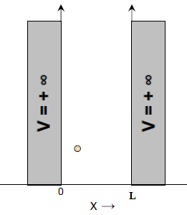
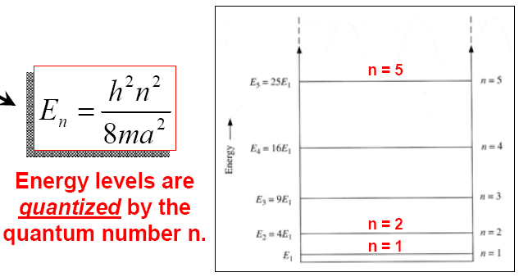
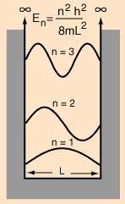
Particle in a rigid box
Boundary conditions:
V=∞ for x≤0 and x≥L
V=0 for 0 <x<L
The energies are quantized and can be characterized by a quantum number n
The energy cannot be exactly zero
The smaller the confinement, the larger the energy required

Slide 27
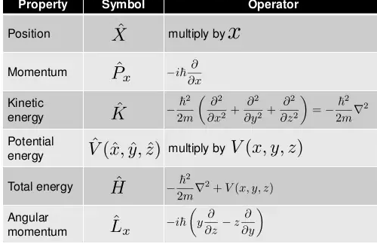
All operators are represented by a symbol with hats

Slide 28
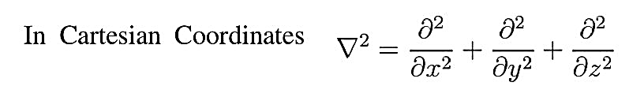
Laplacian operator
Laplacian operator is called an operator because it does something to the function that follows: namely, it produces or generates the sum of the three second-derivatives of the function.

Slide 29
Linear Operators
A function f is called a linear operator if it has the two conditions:
Â(ɸ+ψ)= Âɸ+Âψ
Â(cψ)=c Â (ψ) for all ψ and all constants c.

Slide 30
Hermitian operators
Hermitian operators are operators which satisfy the condition
∫ɸ (Âψ)∗dτ = ∫ψ∗ (Âɸ)dτ
where ɸ and ψ represent any two well behaved functions and dτ is over all space
Ψ* - conjugate of ψ
∫1 (operator on 2)* dτ = ∫ 2* (operator on 1) dτ

Slide 31
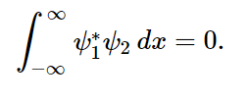
Orthogonal
For two wave function ψ₁ and ψ2, you can say they are orthogonal if
ψ₁ and ψ2 will be perpendicular

Slide 32
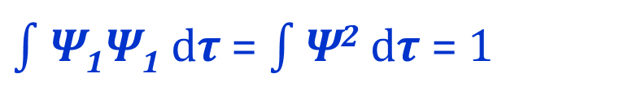
Normalized wave function
$\int{\text{Ψ}\text{1}\text{Ψ}\text{1}}$ d𝝉 = $\int{\text{Ψ}\text{2}}$ d𝝉 = 1
Meaning of above equation
Essentially, normalizing the wave function means you find the exact form of that ensure the probability that the particle is found somewhere in space is equal to 1

Slide 33
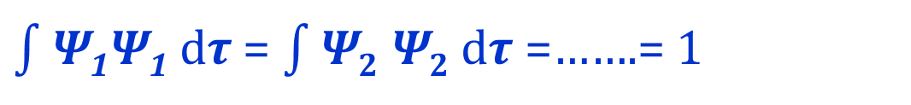
Orthonormal
wave function ψ₁ and ψ2,…… are said to be orthonormal if is satisfies the conditions or normalization and orthogonality.
Orthogonality
$\int{\text{Ψ}\text{1}\text{Ψ}\text{1}}$ d𝝉 = $\int{\text{Ψ}2}$ $\text{Ψ}2$d𝝉 =…….= 1
normalization

Slide 34
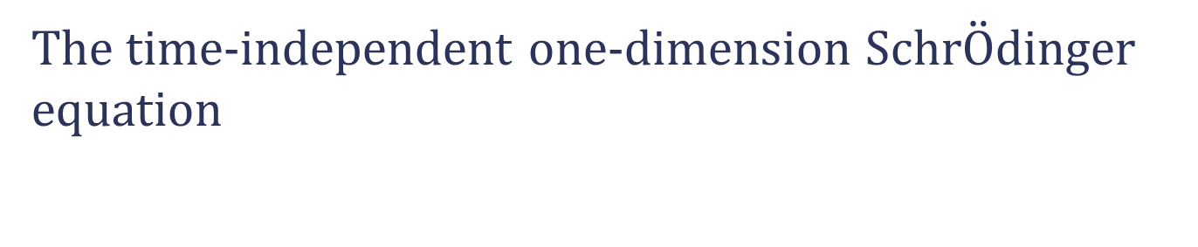
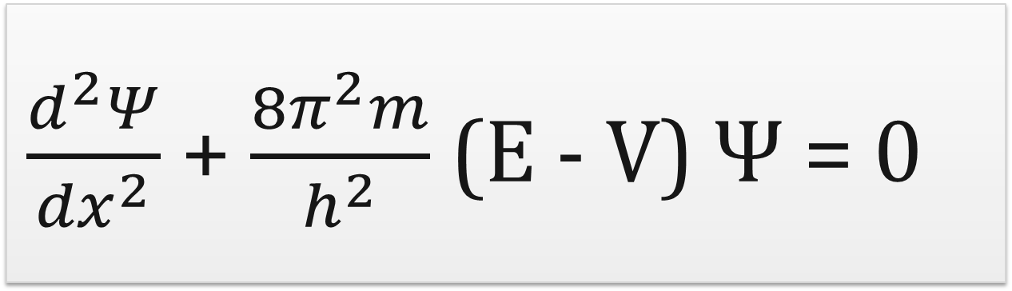

$$\hat{H} ψ=E ψ$$
The time-independent one-dimension Schr$\ddot{O}$dinger equation
$\frac{d^{2}Ψ}{{dx}^{2}}$ + $\frac{{8π}^{2}m}{h^{2}}$ (E - V) Ψ = 0

Slide 35
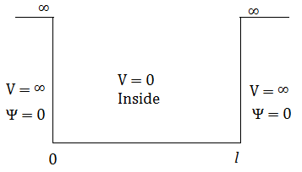
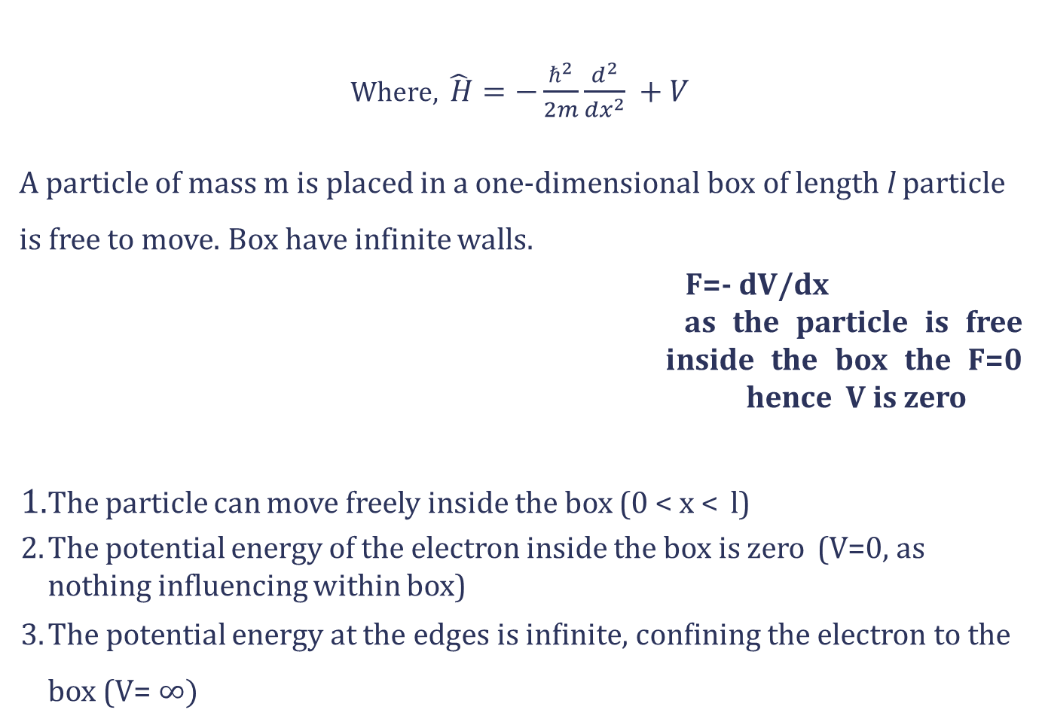

Particle in a One-Dimensional Box
Where, $\hat{ H}=−\frac{ℏ^{2}}{2m}\frac{d^{2}}{{dx}^{2}} +V$
A particle of mass m is placed in a one-dimensional box of length l particle is free to move. Box have infinite walls.
F=- dV/dx
as the particle is free inside the box the F=0 hence V is zero
The particle can move freely inside the box (0 < x < l)
The potential energy of the electron inside the box is zero (V=0, as nothing influencing within box)
The potential energy at the edges is inﬁnite, conﬁning the electron to the box (V= $∞)$
$$\hat{H} ψ=E ψ$$
and
m
x=
x=
When the electron hits the wall, does it loose energy?
No. the energy is constant within the box

Slide 36
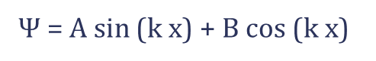
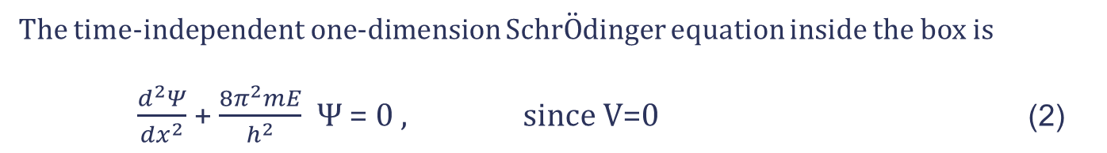
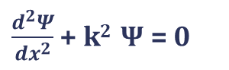
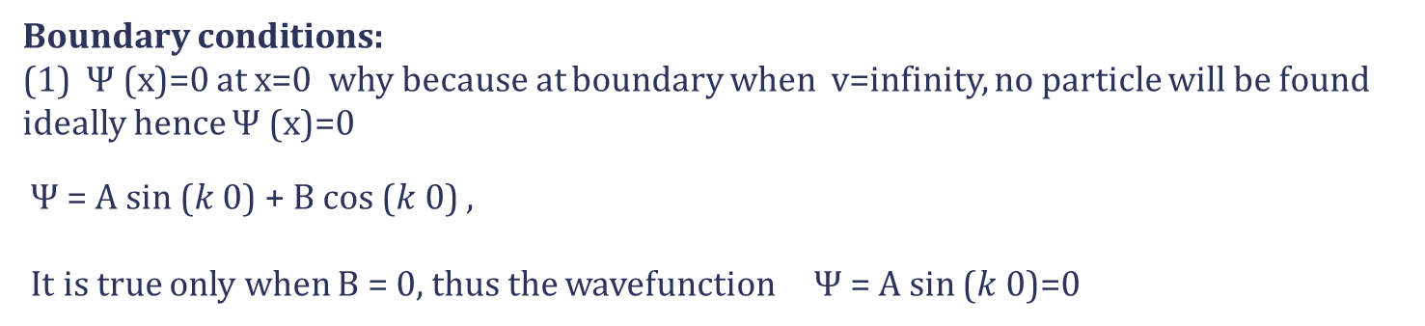

What we are looking for :
Solution for wave functions
energy of the particle
The time-independent one-dimension Schr$\ddot{O}$dinger equation inside the box is
$\frac{d^{2}Ψ}{{dx}^{2}}$ + $\frac{{8π}^{2}mE}{h^{2}}$ Ψ = 0 , since V=0 (2)
$\frac{d^{2}Ψ}{{dx}^{2}}$ + k² Ψ = 0
$Where k$² = $\frac{{8π}^{2}mE}{h^{2}}$
With the general solutions:
Ψ = A sin (k x) + B cos ($k$ x)
Boundary conditions:
(1) Ψ (x)=0 at x=0 why because at boundary when v=infinity, no particle will be found ideally hence Ψ (x)=0
Ψ = A sin ($k$ 0) + B cos ($k$ 0) ,
It is true only when B = 0, thus the wavefunction Ψ = A sin ($k$ 0)=0

Slide 37

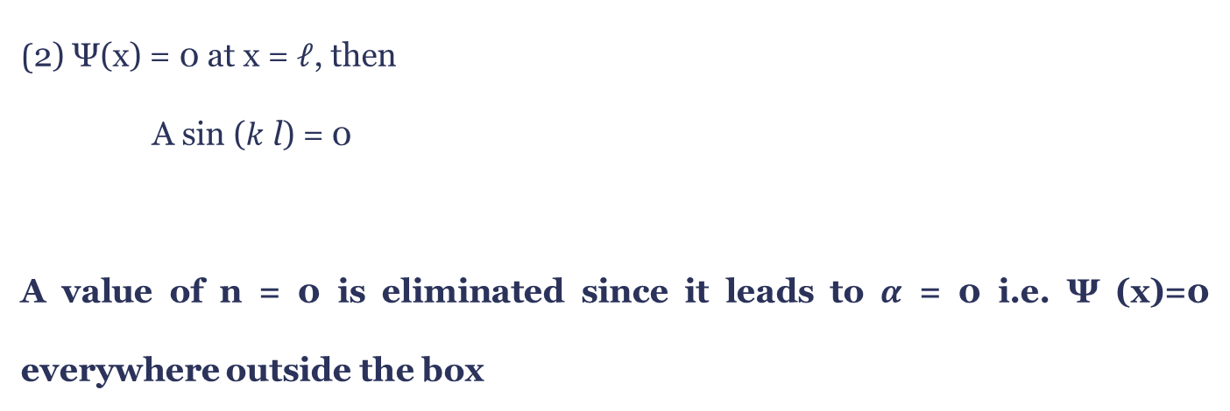
(2) Ψ(x) = 0 at x = 𝓁, then
A sin ($k$ l) = 0
A value of n = 0 is eliminated since it leads to $α$ = 0 i.e. Ψ (x)=0 everywhere outside the box
Ψ_{n} = A sin$\left(\frac{\text{n}\text{π}\text{x}}{l}\right)$
(0 < x < l)
Wavefunction of Particle in 1D box

Slide 38
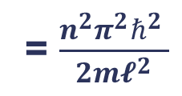
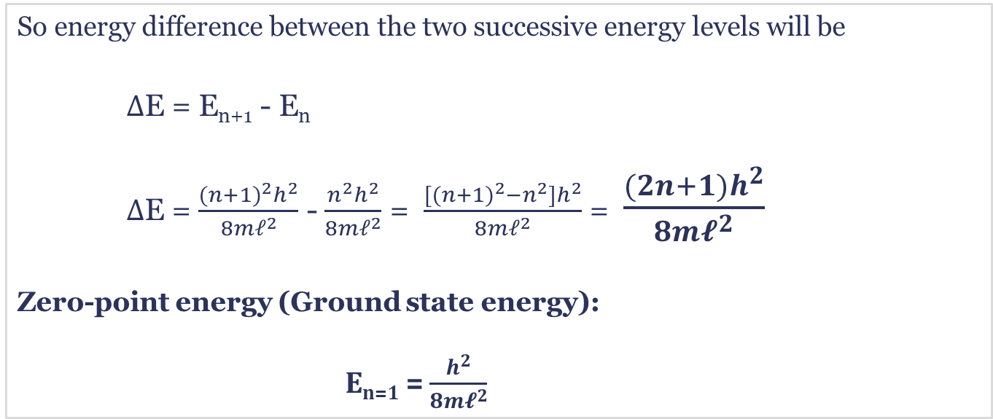
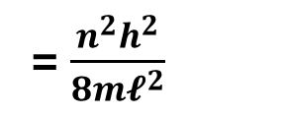
Energy of a particle in 1-D box is quantized.
E
= $\frac{n^{2}{π^{2}ℏ}^{2} }{{2m𝓵}^{2}}$
= $\frac{n^{2}h^{2}}{{8m𝓵}^{2}}$
So energy difference between the two successive energy levels will be
$∆$E = E_{n+1} - E_{n}
$∆$E = $\frac{{(n+1)}^{2}h^{2}}{{8m𝓁}^{2}}$ - $\frac{n^{2}h^{2}}{{8m𝓁}^{2}}$ = $\frac{[(n+{1)}^{2}−n^{2}]h^{2}}{{8m𝓁}^{2}}$ = $\frac{(2n+1)h^{2}}{{8m𝓵}^{2}}$
Zero-point energy (Ground state energy):
E_{n=1} = $\frac{h^{2}}{{8m𝓵}^{2}}$

Slide 39

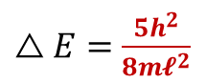
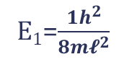
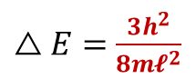

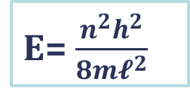
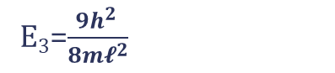
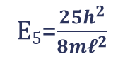
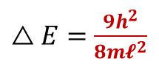
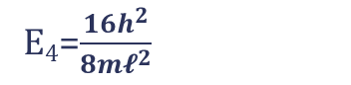
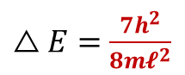
Spacing between successive states becomes progressively larger as ‘n’
increases
The energy spacing between successive states
E₅=$\frac{25h^{2}}{{8m𝓵}^{2}}$
n=5
$△E=$ $\frac{9h^{2}}{{8m𝓵}^{2}}$
E= $\frac{n^{2}h^{2}}{{8m𝓵}^{2}}$
E₄=$\frac{16h^{2}}{{8m𝓵}^{2}}$
n=4
$△E=$ $\frac{7h^{2}}{{8m𝓵}^{2}}$
n=3 (2nd excited state)
E₃=$\frac{9h^{2} }{{8m𝓵}^{2}}$
$△E=$ $\frac{5h^{2}}{{8m𝓵}^{2}}$
n=2 (1st excited state)
E₂=$\frac{4h^{2}}{{8m𝓵}^{2}}$
$△E=$ $\frac{3h^{2}}{{8m𝓵}^{2}}$
n=1(ground state)
E₁=$\frac{1h^{2}}{{8m𝓵}^{2}}$
Zero point energy
X =0
X =l

Slide 40








Normalization Condition
$$\int_{0}^{l}{Ψ_{n}^{2}} dx=1$$
And we know , Ψ = A sin$\left(\frac{\text{n}\text{π}\text{x}}{l}\right)$
$$\int_{0}^{l}{{A }^{2}\sin^{2} (\frac{nπx}{l})} dx=1$$
A = $\sqrt{\frac{2}{l}}$
Any wavefunction can be normalized
by multiplying with a normality constant
Normalization constant
Therefore the normalized wave function for particle in 1D box is:
$$\sqrt{\frac{2}{l}}$$
n=1, 2, 3,…
$$l$$

Slide 41





Graph of Wave Functions
The wave function ψ(x) is sinusoidal . The number of nodes increases by 1 for each successive state.
No. of nodes = (n-1)
$Ψ_{3}$= A sin$\left(\frac{\text{3}\text{π}\text{x}}{l}\right)$
2 nodes
n=2
$Ψ_{2}$= A sin$\left(\frac{\text{2}\text{π}\text{x}}{l}\right)$
Ψ = A sin$\left(\frac{\text{n}\text{π}\text{x}}{l}\right)$
1 node
n=1
$Ψ_{1}$= A sin$\left(\frac{\text{π}\text{x}}{l}\right)$
0 node
n=0
x= 0
x= l

Slide 42


Graph of Probability density
Maxima = n
Maxima=3
n=3
Maxima=2
n=2
Maxima=1
n=1

Slide 43

Graphical representation of Wave Functions and Probability

Slide 44

Zero point energy
The term zero-point energy (ZPE) is same as that of ground state .
Zero-point energy (ZPE) is the lowest possible energy that a quantum mechanical
system may have
Degeneracy
E₃
E₂
For 1D box, only one electron at each energy level hence the
degeneracy 1s 1, E= $\frac{{nx}^{2}h^{2}}{{8m𝓵}^{2}}$
Where as when it is in 2D box (x and y direction) then nx=ny then degeneracy will be 1
And if nx ≠ ny then degeneracy will be 2.
E= $\frac{{(nx}^{2}{+ny2)h}^{2}}{{8m𝓵}^{2}}$
E₁
E₃
E₂
E₁

Slide 45

Schrodinger’s cat
After consultation with Einstein, Schrodinger proposed a thought experiment in which he highlighted the apparent inconsistencies between the so-called Copenhagen interpretation of Quantum Mechanics and the reality of macroscopic measurements.
He proposed that a cat be placed in a sealed box. The release of a poison is then subject to the probabilistic decay of a radioactive isotope. If the isotope decays, the poison is released. If no decay occurs, the poison is not released.
The result is that the cat is in a superposition of states between being dead, and being alive. This is very unintuitive.

Slide 46


Tunneling Effect

Slide 47



Tunneling in Quantum Mechanics

Slide 48




Tunnel Diode
P and N regions are heavily doped
The depletion region is very narrow (~ 10⁻⁸ m) and conduction band of N region overlaps with valence band of P region
Fermi level of N-region merge into CB band and that of P-region into VB
At thermal equilibrium
As depletion region is very narrow, electrons can “tunnel” through the forbidden band due to tunneling.
Electrons tunnel in both directions across the gap and the Fermi energy level is constant across the diode
Forward bias operation
As voltage begins to increase, electrons first tunnel through the depletion region due to alignment of bands.
With further increase these states become misaligned and the current drops — this is called negative resistance, because current decreases with increasing voltage.
With more forward bias
With more forward bias two bands do not overlap. Electrons travel by conduction across the PN junction, and no longer by tunneling through the PN junction barrier. The diode begins to operate as a normal diode.

Slide 49



Scanning Tunneling Microscope (STM)

Slide 50

Working of STM
Currents Control the Surface An extremely fine conducting probe is held close to the sample. Electrons tunnel between the surface and the stylus, producing an electrical signal. The stylus is extremely sharp, the tip being formed by one single atom. It slowly scans across the surface at a distance of only an atom's diameter. The stylus is raised and lowered in order to keep the signal constant and maintain the distance. This enables it to follow even the smallest details of the surface it is scanning. Recording the vertical movement of the stylus makes it possible to study the structure of the surface atom by atom. A profile of the surface is created, and from that a computer-generated contour map of the surface is produced.

Slide 51




STM
Graphite
Silicon
C 60 Molecule

Slide 52


Manipulating with atoms with STM
Donald Eigler and Erhard Schweizer of the IBM Almaden Research Center in San Jose, California, used a scanning tunneling microscope, which can discern individual atoms, to position xenon atoms to form the initials "IBM". (1989)

Slide 53


Slide 54



Slide 55


Slide 56


Slide 57


Slide 58


